Slide 1
Retention of School Mental Health Professionals
Mental Health Evaluation, Training, Research, and Innovation Center for Schools (METRICS)
April 18, 2024
Notes:
Katie

Slide 2
AGENDA
01
INTRODUCTIONS
02
STRATEGIES FOR RETENTION
03
04
SUCCESS STORIES FROM THE FIELD
Q/A WITH
PANELISTS
05
NEXT STEPS & CLOSING
Notes:
Katie

Slide 3
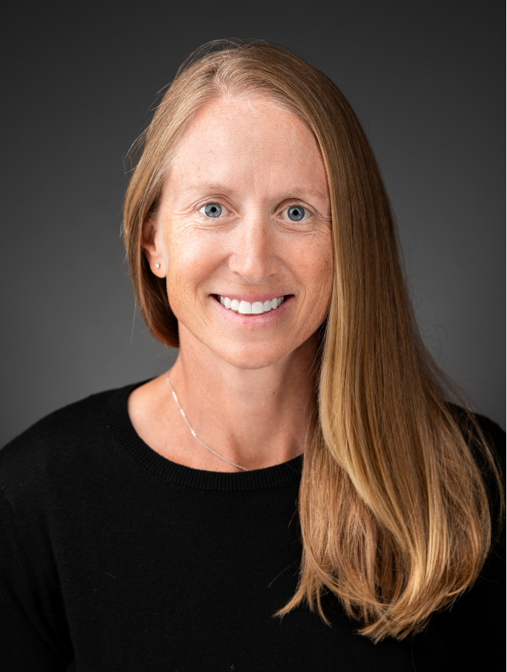
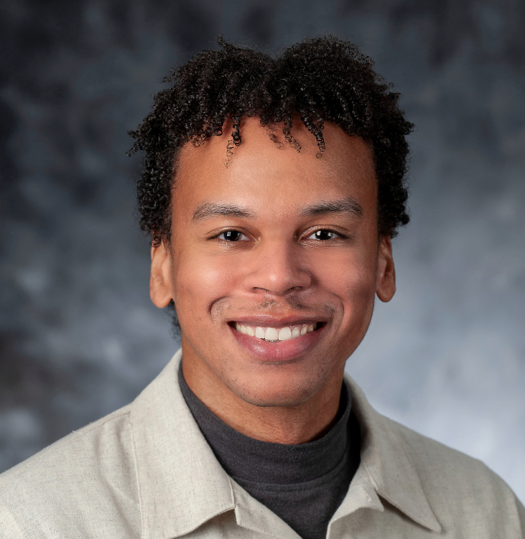
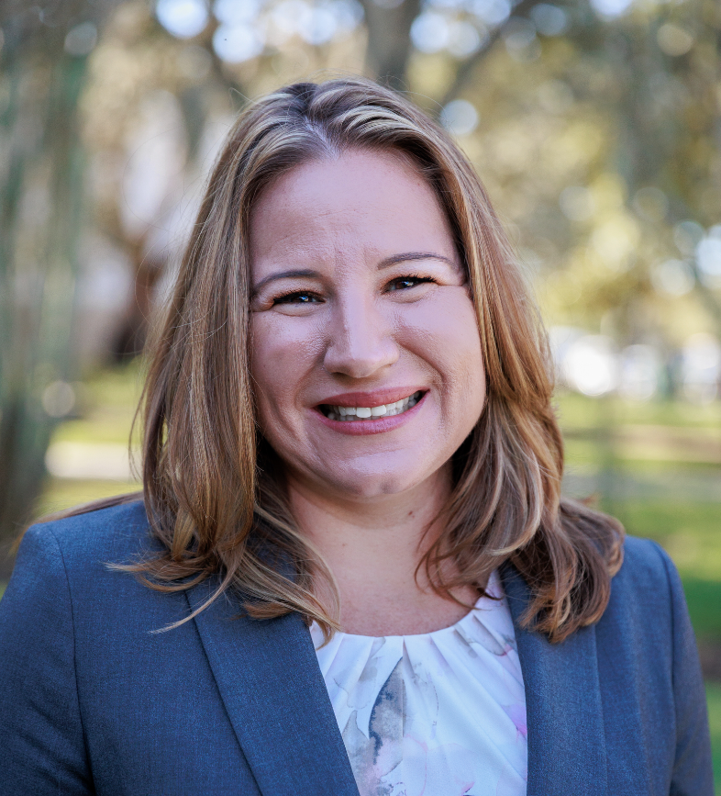
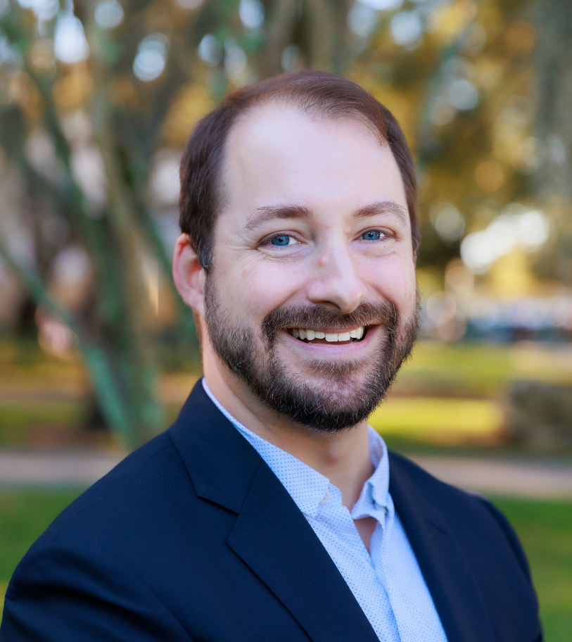
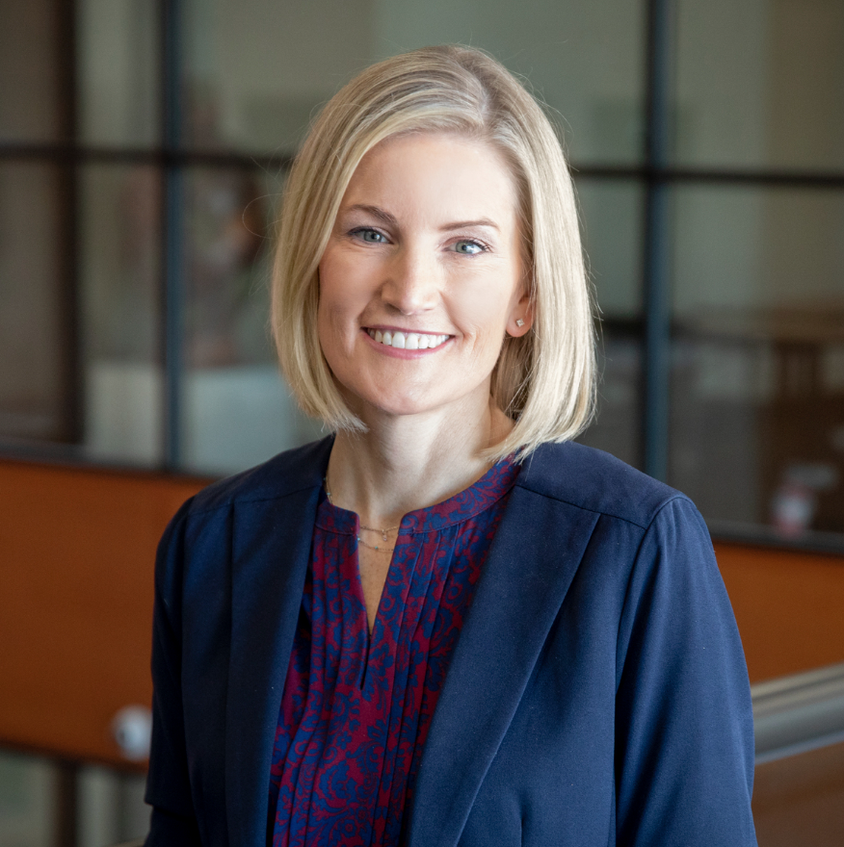
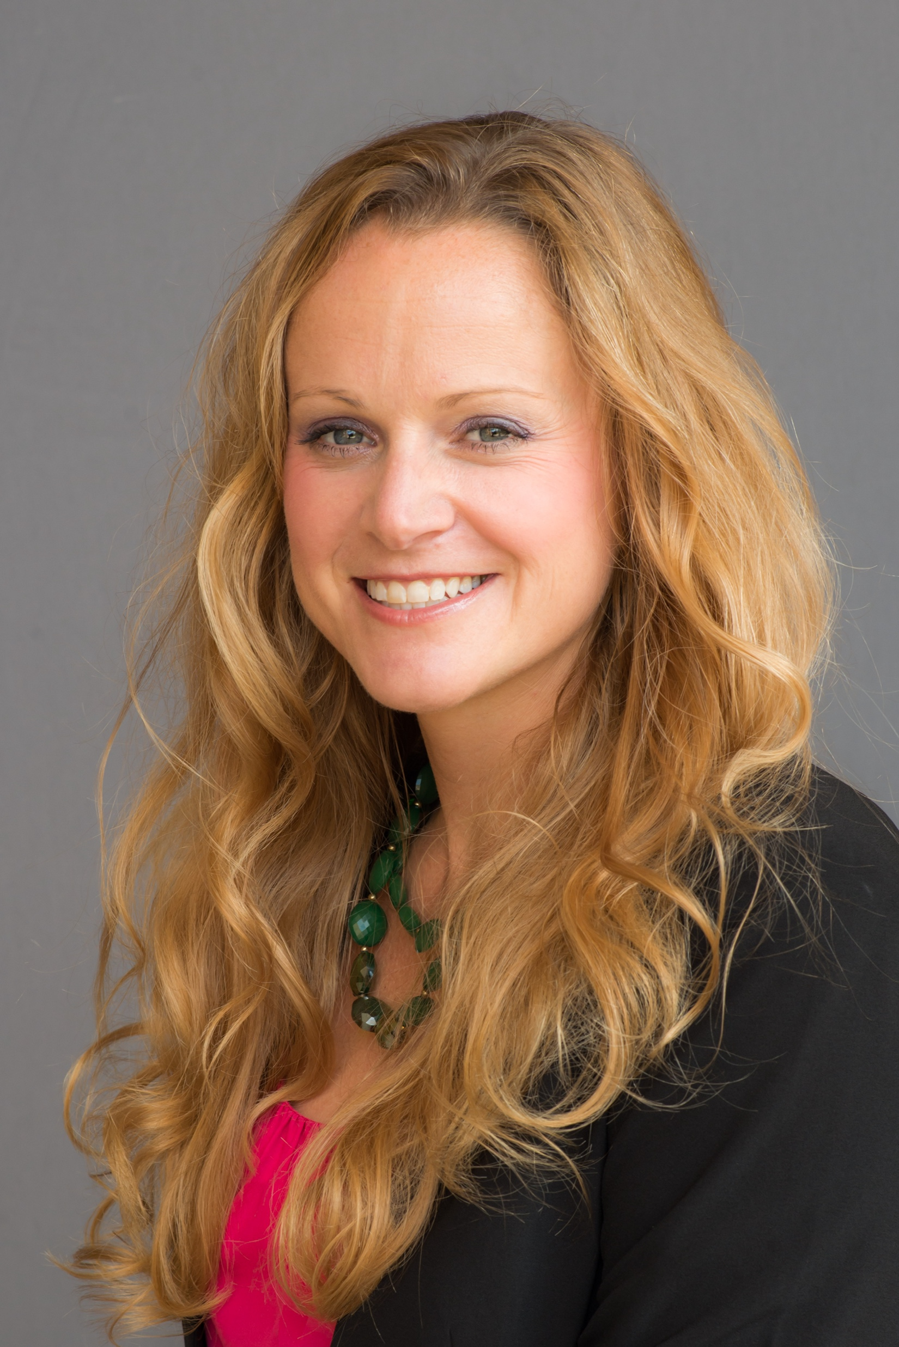
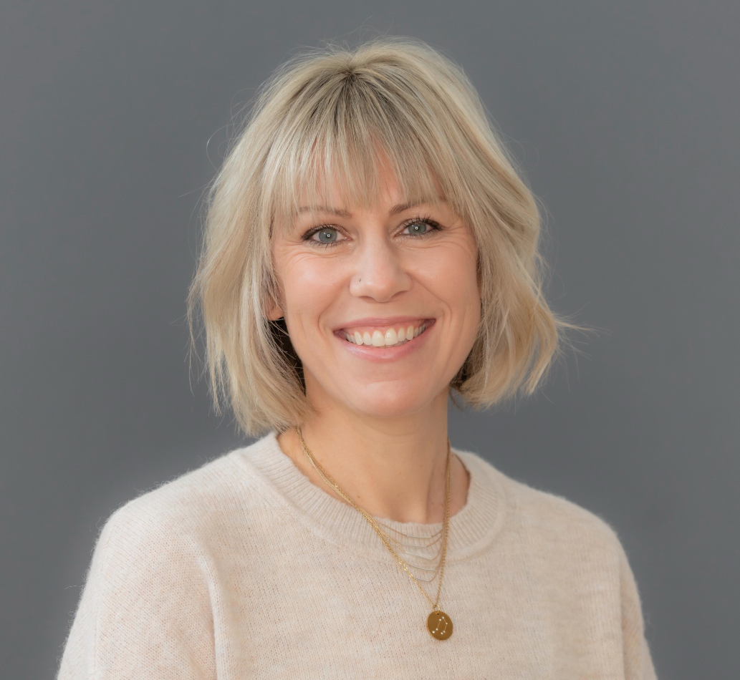
Today's Presenters:
METRICS
ERIN DOWDY
JON GOODWIN
SHANNON SULDO
EVAN DART
KATIE EKLUND
ALLISON BRUHN
GERTA BARDHOSHI
KARI VOGELGESANG
Notes:
Katie

Slide 4
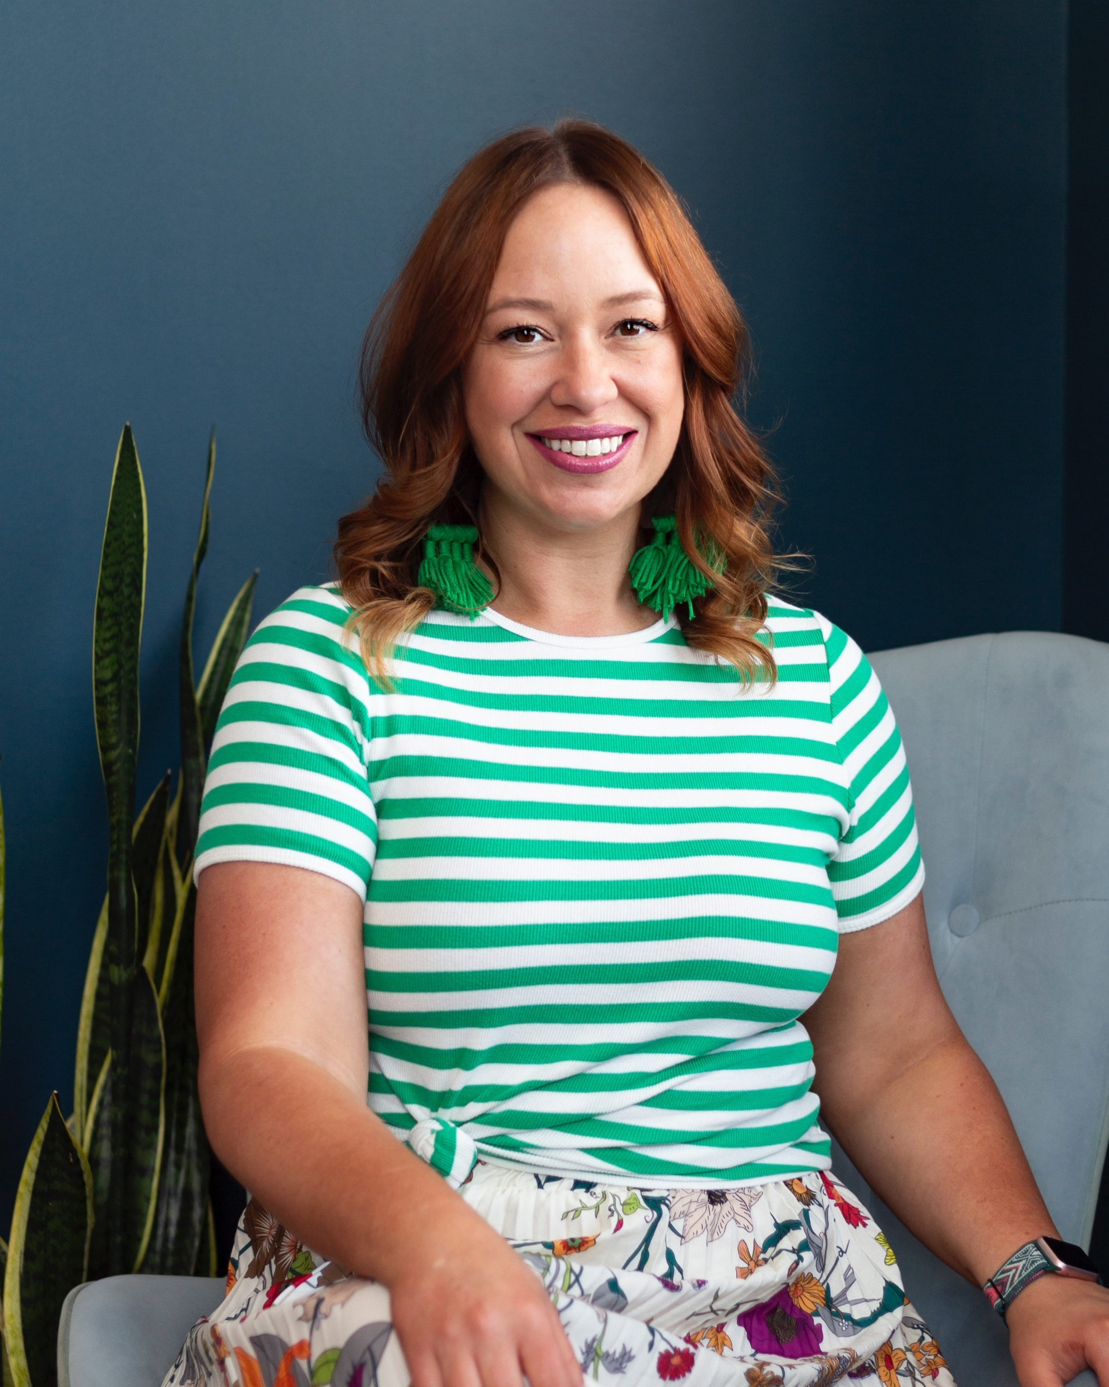
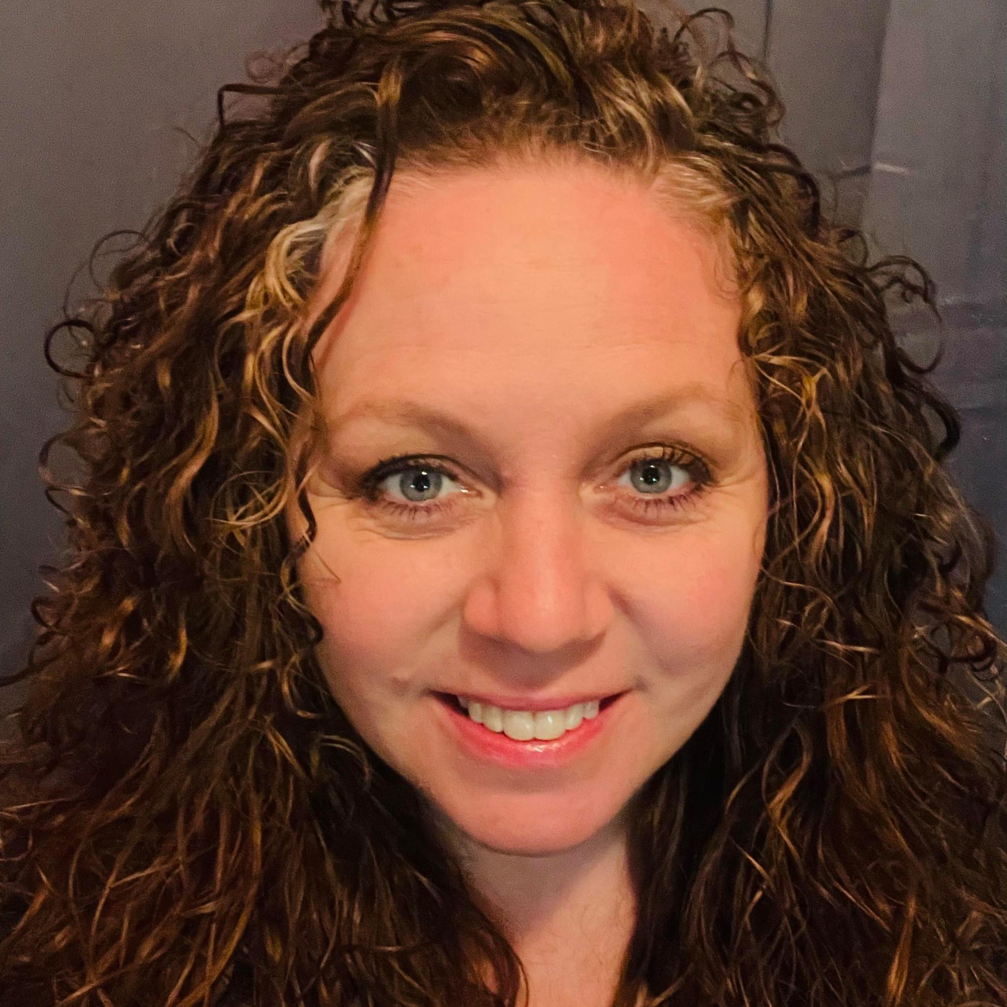
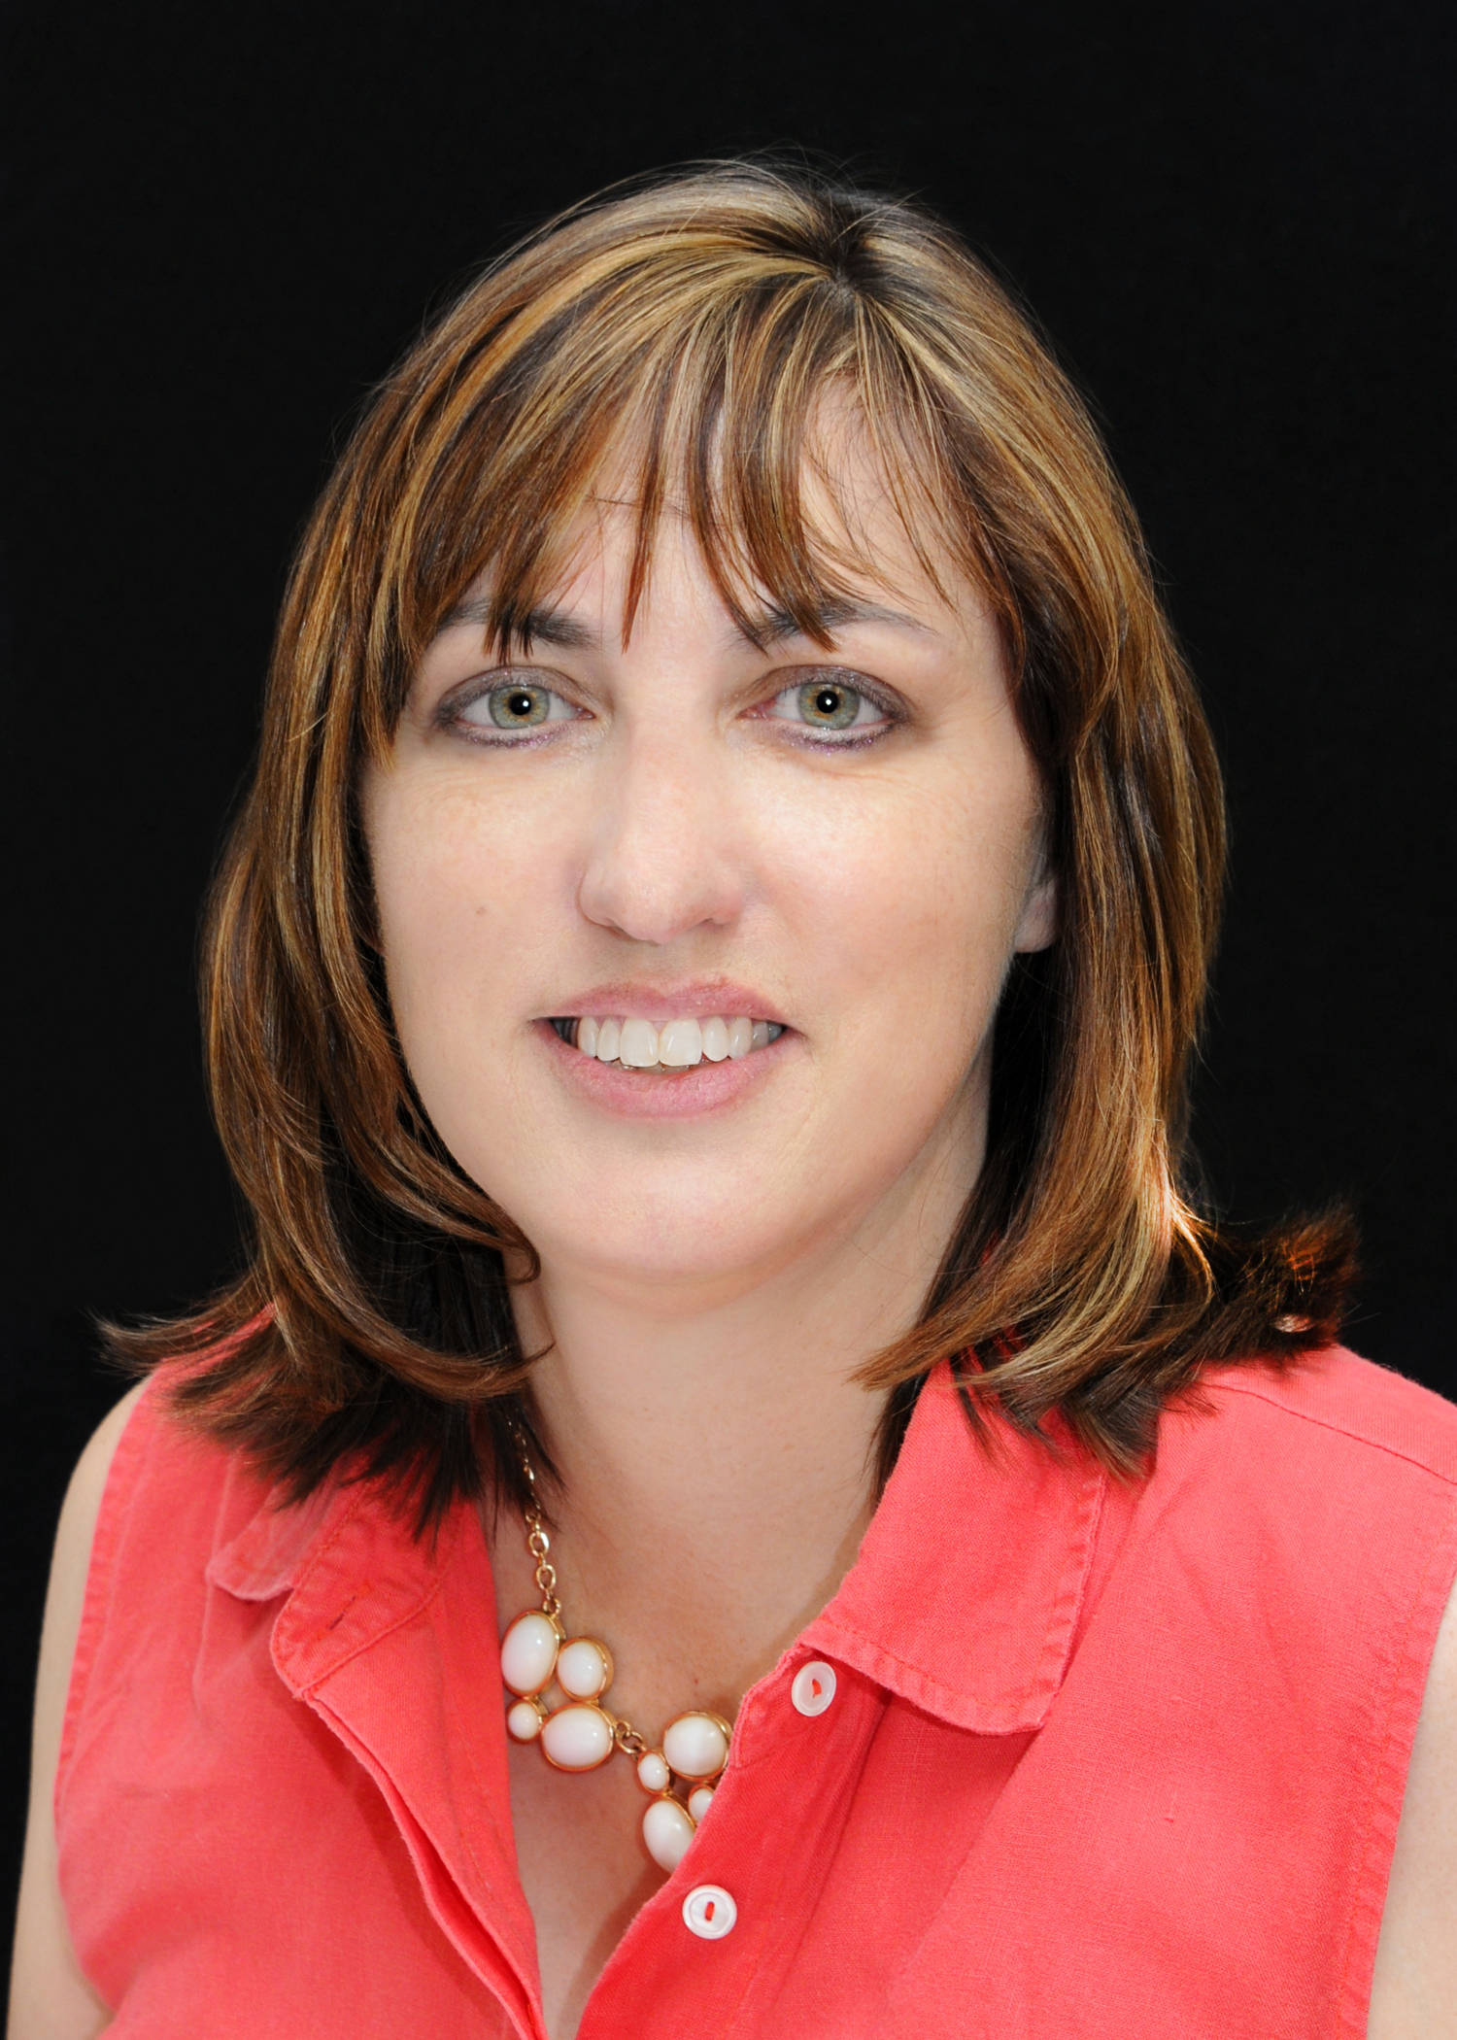
Today's Presenters:
Success Stories from the Field
LORI CARMACK
Hamilton Schools, TN
KELLIE ANDERSON
Anne Arundel County Public Schools, MD
REBECCA DAMRON
Oklahoma State DOE
Notes:
Rebecca Damron, Oklahoma State DOE
Lori Carmack, Hamilton Schools, TN
Kellie Anderson, Anne Arundel AACPS, MD
These presenters will share:
Brief Description of Grant
Strategies for Retention
Successful Experiences

Slide 5
METRICS Goals
Provide technical assistance to MHSP and SBMH grantees via a tiered approach
Disseminate resources related to the recruitment, RETENTION, training, supervision, and credentialing of SMH practitioners
Support grantees in collecting, analyzing, and reporting performance data
Evaluate performance data to identify successes, challenges, and noteworthy trends across grant programs
Notes:
Katie

Slide 6
WELCOME
Mental Health Service Professional Demonstration Grantees
How do we RETAIN our Mental Health Service Providers?
School Based Mental Health Services Grantees
Notes:
Evan

Slide 7
Important Reminders: Be Intentional
Retention
Recruitment
Notes:
Evan
Have a plan – hiring is important but want them to stay
Recruitment is retention and retention is recruitment
REFER attendees to recruitment slide

Slide 8
Retention Data
Within the first two years...
59% of school counselors leave their position
49% of school social workers leave their position
50% of school psychologists leave their position
Notes:
Evan

Slide 9
Reasons for Leaving the Field
TRAINING PROGRAMS | PROFESSIONAL POSITIONS
Misalignment with Career Objectives "I didn't know what I was getting myself into" | Occupational Stress & Burnout "Wow, this job is stressful! I need more time in a day!"
Lack of Belonging & Community "I don't fit in here." | Lack of Supervision & Organizational Support "I need help. I'm all on my own. No one values me."
Financial Stressors "School is expensive." | Financial Stressors "I could move districts or jobs and make more $."
Inadequate Advising & Support "My advisor is barely here and barely knows I exist." | Administrative Pressures "I keep being asked to take on more and I am afraid to say no."
Notes:
Alison
Proctor and Truscott (2010) analyzed the reason for attrition from a small sample of African American students previously enrolled in a school psychology program. Participants reported a misalignment with the career objectives, program’s failure to meet expectations, job constraints, and a lack of relationship with peers and faculty as reasons for their decision to leave their respective program (Proctor & Truscott, 2010).

Slide 10
Retention Strategies
Competitive Compensation and Benefits
Opportunities for Professional Development
Promote Work-Life Harmony
Recognition & Appreciation
Celebrate achievements
Create a Positive Work Environment
Feelings of support and belongingness
Workshops & Conferences
Use Vacation Time
PTO for PD
Help Managing Workload
Teamwork
Retention Bonus
Stipends for PD & Supervisors
Licensure/Credential Fees
Loan Repayment
Childcare coverage/costs
Notes:
Gerta
Competitive Compensation and Benefits:
Ensure that mental health professionals receive competitive salaries and benefits. Recognize and reward their expertise and dedication to the well-being of students.
Professional Development Opportunities:
Provide ongoing opportunities for professional growth and development. This can include workshops, conferences, and training sessions to enhance their skills and keep them engaged.
Mentorship Programs:
Establish mentorship programs where experienced mental health professionals can guide and support newer staff members. This can foster a sense of community and help build professional relationships.
Work-Life Balance:
Promote a healthy work-life balance to prevent burnout. Encourage mental health professionals to take breaks, use their vacation time, and manage their workload effectively.
Recognition and Appreciation:
Acknowledge and appreciate the contributions of mental health professionals regularly. Celebrate their achievements, both big and small, to boost morale and job satisfaction.
Flexible Schedules:
Offer flexible work schedules or remote work options when possible. This can help accommodate personal needs and improve overall job satisfaction.
Create a Positive Work Environment:
Foster a supportive and positive workplace culture. Encourage open communication, teamwork, and a sense of belonging among mental health professionals and the broader school staff.
Create a Positive Work Environment
Culture & climate of your school or university
Providing well-being supports
Interpersonal staff relationships
Proctor and colleagues (2014) suggest diversity recruitment should focus on program administrative support, outreach efforts, and inclusionary practices to raise awareness of the field and of its commitment to diversity. Another tactic is to create in-person or media presentations that can be distributed through minority-specific listservs, colleges, and cultural centers (Bocanegra et al., 2015). Also, school psychology scholars can collaborate with minority specific psychology organizations and present school psychology information to undergraduate psychology courses (Bocanegra, et al., 2015). When it comes to school psychology graduate program websites, administrators should focus on adding minority funding opportunities, multicultural degree options, and diversity statements to show their intent to attract racially and ethnically diverse students (Smith et al., 2016). By showing a commitment to diversity on school psychology websites, diverse students may feel more comfortable in applying to that specific school knowing they will be supported.
At the institutional level, Grapin et al. (2016) recommends that institutions strive to have a substantial representation of minority faculty and faculty that are interested in diversity topics. Institutions can also provide funding for fellowship and employment opportunities that allows diverse students to fund their education easily (Grapin et al., 2016). For example, at the University of California, Santa Barbara, the graduate division has created the Racial Justice Fellowship that provides recipients interested in racial justice research with summer funding on top of a five year funding package (Perko, 2020). This type of support shows a commitment to diversity and racial justice initiatives. Another strategy is to create summer research programs for minorities to engage in with proper funding (Grapin et al., 2016). For example, in the California State University system, the California Pre-Doctoral program is a program intended to help REM students pursue doctoral education (Summer Research Opportunities, 2021). One aspect of the program is fully funding a summer research opportunity in an effort to connect students with doctoral research while alleviating the financial costs associated with doing so (Summer Research Opportunities, 2021). These opportunities may give students the confidence to pursue graduate education and gain experience in their field of choice.
Having diverse faculty would likely mean more opportunities for diverse graduate students to engage in meaningful research with specific populations. It could also mean that diverse students feel more supported knowing there is faculty present with similar cultural backgrounds. Additionally, having minority funding and employment opportunities can alleviate the financial stressors disproportionately associated with REM students pursuing graduate education. Essentially, it is important that institutions commit themselves to providing opportunities to marginalized students that may make their transition to graduate school easier. After recruitment is addressed, future research should examine the factors associated with retaining school psychology faculty and school psychologists in practice.

Slide 11
and More!
Provide Feedback & Set Realistic Expectations
Shared Decision Making
Address Burnout
Provide Leadership Opportunities
Secondary Traumatic Stress
Self-Compassion & Time to Debrief
Clinical Supervision
Peer Supervision Networks
Connect with State/Prof Orgs
Connect w Local Universities
Establish Mentorships
Flexible Work Arrangements
Role Clarification & Adjustments
Wellness Programs
Notes:
Gerta
Competitive Compensation and Benefits:
Ensure that mental health professionals receive competitive salaries and benefits. Recognize and reward their expertise and dedication to the well-being of students.
Professional Development Opportunities:
Provide ongoing opportunities for professional growth and development. This can include workshops, conferences, and training sessions to enhance their skills and keep them engaged.
Mentorship Programs:
Establish mentorship programs where experienced mental health professionals can guide and support newer staff members. This can foster a sense of community and help build professional relationships.
Work-Life Balance:
Promote a healthy work-life balance to prevent burnout. Encourage mental health professionals to take breaks, use their vacation time, and manage their workload effectively.
Recognition and Appreciation:
Acknowledge and appreciate the contributions of mental health professionals regularly. Celebrate their achievements, both big and small, to boost morale and job satisfaction.
Flexible Schedules:
Offer flexible work schedules or remote work options when possible. This can help accommodate personal needs and improve overall job satisfaction.
Create a Positive Work Environment:
Foster a supportive and positive workplace culture. Encourage open communication, teamwork, and a sense of belonging among mental health professionals and the broader school staff.
Create a Positive Work Environment
Culture & climate of your school or university
Providing well-being supports
Interpersonal staff relationships
Proctor and colleagues (2014) suggest diversity recruitment should focus on program administrative support, outreach efforts, and inclusionary practices to raise awareness of the field and of its commitment to diversity. Another tactic is to create in-person or media presentations that can be distributed through minority-specific listservs, colleges, and cultural centers (Bocanegra et al., 2015). Also, school psychology scholars can collaborate with minority specific psychology organizations and present school psychology information to undergraduate psychology courses (Bocanegra, et al., 2015). When it comes to school psychology graduate program websites, administrators should focus on adding minority funding opportunities, multicultural degree options, and diversity statements to show their intent to attract racially and ethnically diverse students (Smith et al., 2016). By showing a commitment to diversity on school psychology websites, diverse students may feel more comfortable in applying to that specific school knowing they will be supported.
At the institutional level, Grapin et al. (2016) recommends that institutions strive to have a substantial representation of minority faculty and faculty that are interested in diversity topics. Institutions can also provide funding for fellowship and employment opportunities that allows diverse students to fund their education easily (Grapin et al., 2016). For example, at the University of California, Santa Barbara, the graduate division has created the Racial Justice Fellowship that provides recipients interested in racial justice research with summer funding on top of a five year funding package (Perko, 2020). This type of support shows a commitment to diversity and racial justice initiatives. Another strategy is to create summer research programs for minorities to engage in with proper funding (Grapin et al., 2016). For example, in the California State University system, the California Pre-Doctoral program is a program intended to help REM students pursue doctoral education (Summer Research Opportunities, 2021). One aspect of the program is fully funding a summer research opportunity in an effort to connect students with doctoral research while alleviating the financial costs associated with doing so (Summer Research Opportunities, 2021). These opportunities may give students the confidence to pursue graduate education and gain experience in their field of choice.
Having diverse faculty would likely mean more opportunities for diverse graduate students to engage in meaningful research with specific populations. It could also mean that diverse students feel more supported knowing there is faculty present with similar cultural backgrounds. Additionally, having minority funding and employment opportunities can alleviate the financial stressors disproportionately associated with REM students pursuing graduate education. Essentially, it is important that institutions commit themselves to providing opportunities to marginalized students that may make their transition to graduate school easier. After recruitment is addressed, future research should examine the factors associated with retaining school psychology faculty and school psychologists in practice.

Slide 12
Retaining SMH Professionals from Diverse Backgrounds
Facilitate professional communities with other diverse faculty or professionals.
Support membership within professional organizations focused on supporting minoritized professionals.
Establish a workplace climate that is supportive of diversity and celebrating diverse heritages.
Ongoing professional development for both minoritized and non-minoritized colleagues to support equity and inclusion.
Mentorship from more experienced diverse SMH professionals
Notes:
Jon
Retention of diverse SMH
Coordinating/facilitatiing professional communities with other diverse faculty
Supporting membership with professional organizations focused on supporting minoritized professions
Establishing a climate that is supportive of diversity and celebrating diverse heritages

Slide 13
Success Stories from the Field
Kellie Anderson, Anne Arundel AACPS, MD
Lori Carmack, Hamilton Schools, TN
Rebecca Damron, Oklahoma State DOE
Brief Description of Grant
Strategies for Retention
Successful Experiences
Notes:
Shannon to Introduce – 5-10min max

Slide 14
Grant Context
Goal: hire and retain 8 school social workers
Increased from 27 to 73 SSWs (8 funded by grant) in about a year along with changing SSW delivery model from family- to student-facing
Supervision of SSW: coordinator + 2 leads
Strategies for Retention
1:1 supervision with the 3 administrative SSWs
Monthly peer learning community meetings
Monthly practitioner-selected PD (1/2 to full day)
Stipends for clinical supervisors
Successful Experiences
Monthly PD blended with restorative circles for processing concerns and successes
High demand for clinical supervision for LCSW
Hamilton County Department of Education
Lori Carmack, LMSW, LSSW
Coordinator of School Social Work
Social Emotional and Academic Development (SEAD) Department
Chattanooga, TN
carmack_lori@hcde.org
SBMH Grant:
Hamilton County Schools, School Based Mental Health Services Project
Notes:
Shannon introduce Lori
We invited her to be one of a few grantees we highlight on the topic of staff retention because of our review of the grant application in late 2023 (after METRICS was established)– described an innovative multi-faceted plan to retain social workers in Hamilton County Schools through a combination of monthly peer learning circles, 1:1 supervision, practitioner-selected PD, and stipends for clinical supervisors.
Lori Carmack, LMSW, LSSW, Coordinator of School Social Work
Social Emotional and Academic Development (SEAD) Department
LORI CARMACK <CARMACK_LORI@HCDE.ORG>
3074 Hickory Valley Road | Chattanooga, TN 37421
(P) 423.344.1477 | ext. 28083
website | facebook | twitter | instagram | youtube
Hamilton County Schools School Based Mental Health Services Project

Slide 15
Grant Context
Goal: hire and retain 14 LMHPs, one for each of the 14 districts/grantees in Pottawatomie County
Strategies for Retention
Prioritized building relationships with districts, community partners and OSU, county counseling agencies
Establish and maintain community for hires and school teams, through monthly:
LMHP Connect Meetings
MTSS Coaching Academy
Successful Experiences
School leaders are active participants and champions of mental health integration
LMHPs feel valued and supported by peers and by school leaders
Oklahoma State
Dept of Education
and
Pottawatomie County
Rebecca Damron
Project Manager
Oklahoma City, OK
Rebecca.Damron@sde.ok.gov
SBMH Grant:
Project RESPECT
Notes:
Shannon introduce Rebecca
Needs assessment response:
13 of 14 awarded districts under our grant have successfully hired a mental health provider for their districts and we feel confident in our ability to support the retention of these providers. When I came onto this project, and in light of the significant turnover our agency and districts experienced, we made the decision to prioritize building relationships with the districts, community partners, and county counseling agencies. Because of that, we are entering this second year with a great sense of momentum and support from the community and districts.
Rebecca met with Shannon on 3/19/24 over Zoom to discuss retention supports.
Rebecca is confident these new hires will be retained due to monthly recurring supports offered to (a) the group of LMHPs (“LMHP Connect Meetings”) and (b) the larger administrative and school mental health teams in each district (“MTSS Coaching Academy”)
Rebecca Damron-Whitehead
Project Manager - Project RESPECT
Oklahoma State Department of Education
2500 N. Lincoln Blvd.
Oklahoma City, OK 73105
(405) 839-4563
Is email as listed on slide, or as in survey: Rebecca.whitehead@sde.ok.gov

Slide 16
Grant Context
Goal: hire and retain diverse school psychologists and social workers in AACPS (large district in MD)
Strategies for Retention
Start with successful recruitment! Help new hires feel supported, and connected to their work and field
Increased intern pool (5 to 7-8 school psych interns)
Social work: created stipend for interns, and employment pathway (intern => LMSW => LCSW, via district-provided supervision); share w/ local universities
Emphasis on employee job quality and mentoring
Paid mentoring for early career diverse hires; travel to 2 conferences; professional dues paid
Successful Experiences
Explicit acknowledgment of importance of diversity in student services staff, with intentional placement to schools and mentors with similar identities
Anne Arundel
County Public Schools
Dr. Kellie Anderson, NCSP
Coordinator
Office of Psychological Services
Annapolis, MD
kjanderson@aacps.org
SBMH Grant:
Recruiting and Retaining School Psychologists in AACPS
Notes:
Shannon introduce Kellie
Needs assessment response: “We have been able to provide good retention supports” as a particular success of the grant at this point
Dr. Kellie Anderson, NCSP Coordinator Office of Psychological Services 410-222-5321 kjanderson@aacps.org

Slide 17
Questions for Panelists
Please ask questions of our wonderful presenters!
Questions in the Chat Box
Raise Hands
Notes:
Erin

Slide 18
Coming Soon: Professional Learning Community
Designed to facilitate continued conversation and growth
"I would appreciate continued conversations with other grantees"
"I'd love to have a thought-partner to think about.....how to enhance retention efforts in my rural district"
Email Coming Soon:
Express Interest
Consider optimal meeting schedule
Structure Example: 1 hr Zoom meetings/1 x month matched with other grantees focused on retention in rural schools
Notes:
Erin
Heads-up about a forthcoming email
https://usf.az1.qualtrics.com/jfe/form/SV_brvYWBkEvuX1KoS

Slide 19
WRAP-UP
01
SHARE IN THE CHAT:
One strategy that you learned today
02
GRATITUDE & REMINDERS
03
FEEDBACK:
Click the link in the chat to provide feedback on the webinar
https://usf.az1.qualtrics.com/jfe/form/SV_3DfwYNCe55tx7IW
Notes:
(from Whitney): Webinar Survey: https://usf.az1.qualtrics.com/jfe/form/SV_3DfwYNCe55tx7IW
Reminder
reach out to PO if you want to rebudget to use funds in a different way
Mental Health Awareness month
https://usf.az1.qualtrics.com/jfe/form/SV_3DfwYNCe55tx7IW
Give 2 min

Slide 20
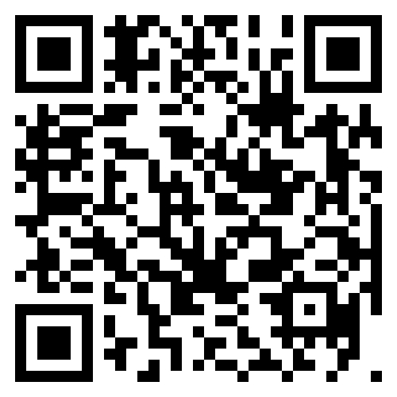
QUESTIONS? Also, you can just reach out to us!
https://metricscenter.org/support
Notes:
Erin
Technical assistance

